Slide 1
CALIFORNIA HOUSING
MARKET INTELLIGENCE
Brian Mellinger, Isaiah Deppong, & Rachel Roberts

Slide 2
Outline
1
Problem
2
Initial Data
3
Methods
4
Results

Slide 3
The Problem
California Housing market is complex and has various regional and economic factors for the valuation of homes.

Slide 4
What is the problem?
1
Problem
How do we predict housing prices in california?
What is influencing the housing factors?

Slide 5
Initial Data
What we were given, and how we decided to work with it.

Slide 6
The Initial Data
2
Initial Data
D
L
Others
Income
Rooms
Target?
Median_housing_price
Data
20,640 data entries
Location
Near bay
<1h Ocean
Inland
Near Ocean
Island

Slide 7
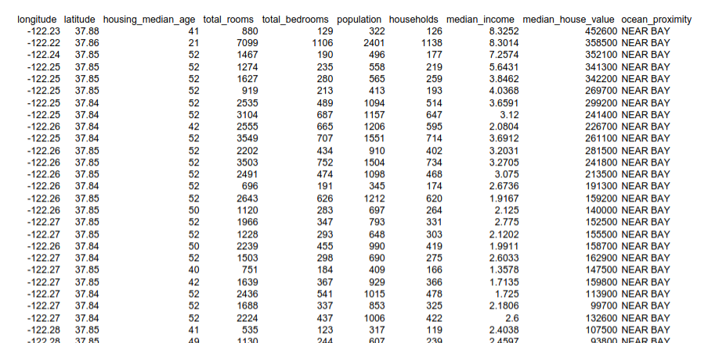
The Dataset

Slide 8
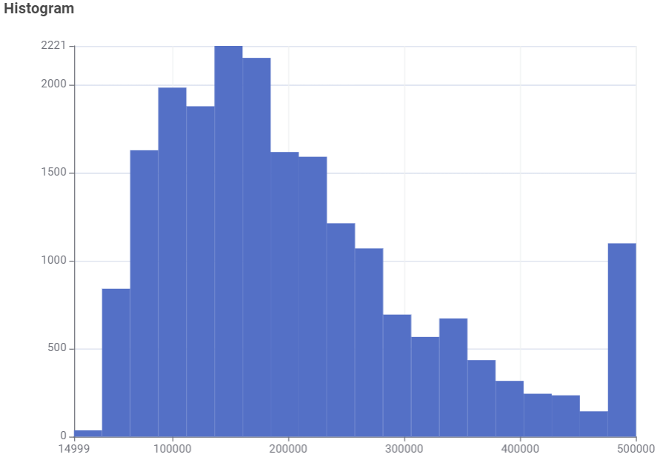
The Initial Data: The housing prices in total
2
Initial Data

Slide 9
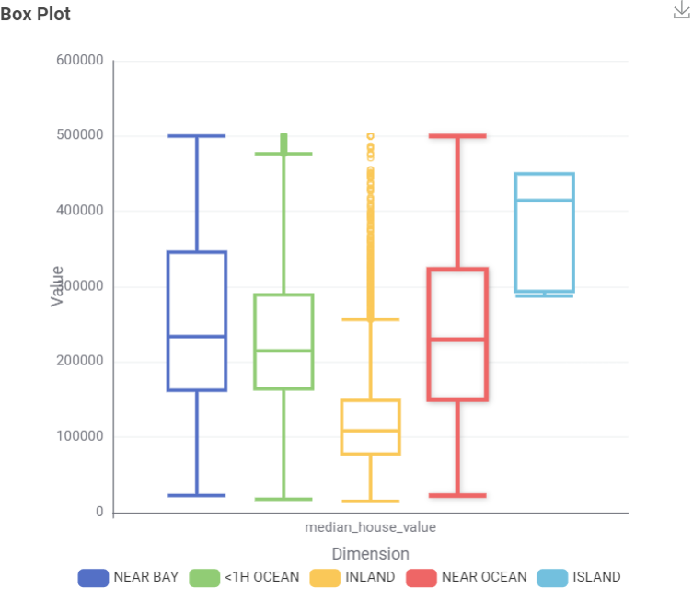
The Initial Data: Housing by location
2
Initial Data

Slide 10
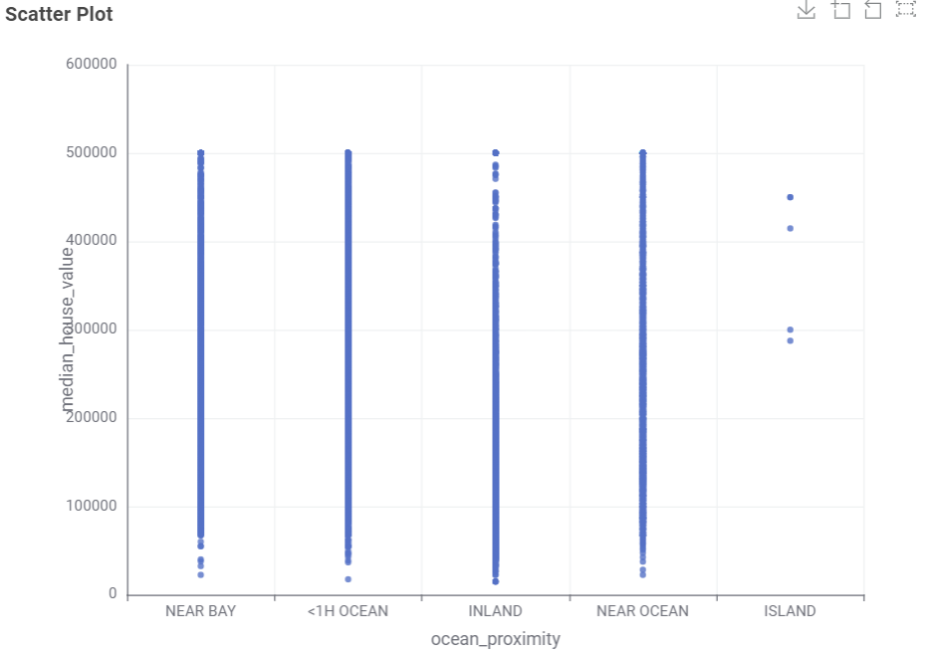
The Initial Data: Housing by location (continued)
2
Initial Data

Slide 11
The Methods
What we attempted to address the issue.

Slide 12
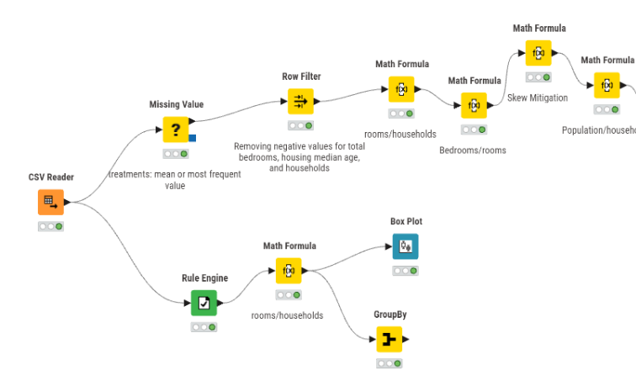
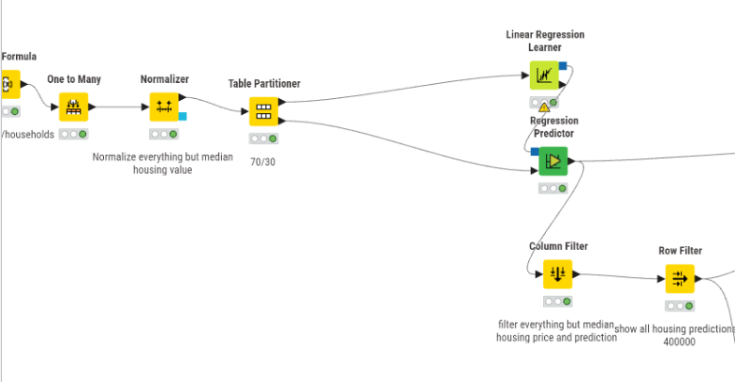
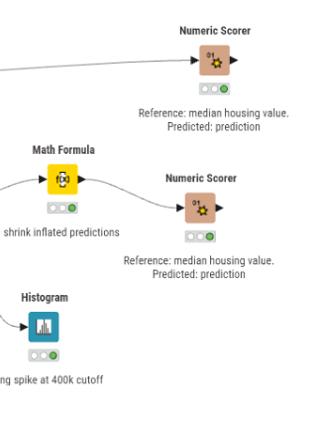
Our Final Knime Workflow:
3
Methods

Slide 13
Methods: The Issue
3
Methods
D
L
The “Why”
This reduces "noise" and prevents the model from over-relying on two versions of the same data point.
The problem?
Multicollinarity
when independent variables in a regression model are highly correlated, meaning one can be linearly predicted from the others
The Action
We removed total_bedrooms to simplify the model.

Slide 14
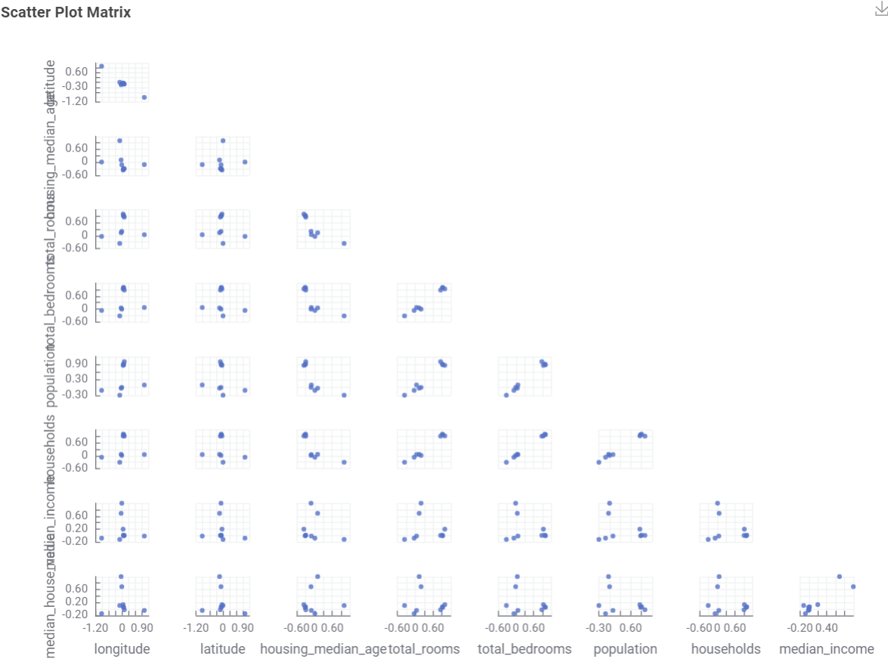
Methods: The Issue cont.
3
Methods
The Visual
This scatterplot shows the constant redundancy of total_bedrooms.
Positive linear correlation between total_rooms
Negative linear correlation between population and median housing value

Slide 15
Data cleanup and feature selection
Data cleanup methods:
Missing values: replace with mean
Remove negative values (not for long/lat)
Adjust the for the housing cap of $499k by discarding those values.
Features Selected
Population
Geographical location
House income
Households
Total rooms

Slide 16
The Results

Slide 17
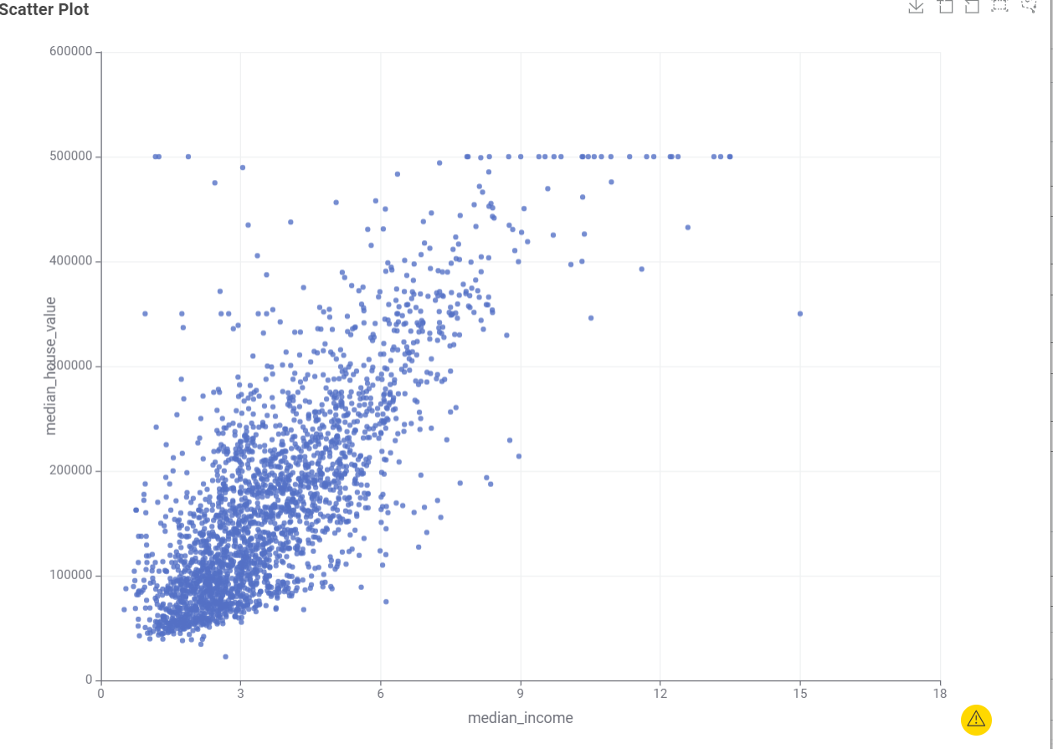
Final Model Achievement
The Big 3:
R^2: 0.914
MAE: Off by ~$26,604
48% improvement over basic linear model
MAPE: 19% error

Slide 18
THANKS
Does anyone have any questions?
bmelling@charlotte.edu
rrober45@charlotte.edu
ideppong@charlotte.edu

